Slide 1

Hostel Management System
Submitted By:
31116 Swapnil Chavhan
31114 Vaishnavi Bhujbal
31104 Aovi Anjankar

Slide 2
PROBLEM STATEMENT
_________________________________________________________________________________________
To Design and develop a hostel management system for storing every information of students related to hostel e.g. Room number, department, year of study etc for efficient handling.

Slide 3
INTRODUCTION
__________________________________________________________________________________________
Under the hostel management system, each and every record of student like attendance is maintained.
Complaints can be registered by students in the system.
The record of visitors coming to visit students is maintained.

Slide 4
MOTIVATION
_______________________________________________________________________________________
For proper managing of all the records of the hostel, an efficient system consisting of all the parameters is essential.
This is of great use to students as well as the hostel committee to store all the information on one platform.

Slide 5
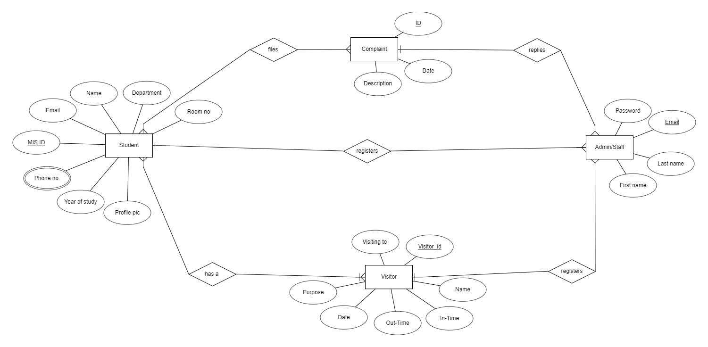
ER Diagram

Slide 6
SCHEMA
_______________________________________________________________________________________
1. Student Table
Sr No | Variable name | Type | Constraint
1 | Name | varchar | Not null
2 | Roll No | int | Primary key
3 | Email | varchar | Not null
4 | Department | varchar | Not null
5 | Year of Study | int | Not null
6 | Gender | varchar | Not null
7 | Phone Number | long | Not null

Slide 7
2. Admin/staff Table
Sr No | Variable Name | Type | Constraint
1 | Email | varchar | Primary Key
2 | First Name | varchar | Not null
3 | Last Name | varchar | Not null
4 | Password | varchar | Not null
3. Complaint Table
Sr No | Variable Name | Type | Constraint
1 | Id | int | Primary key
2 | Date | date | Not null
3 | Description | varchar | Not null

Slide 8
4. Visitor Table
Sr No | Variable Name | Type | Constraint
1 | Visitor_Id | int | Primary Key
2 | Name | varchar | Not null
3 | Date | int | Not null
4 | In_time | time | Not null
5 | Out_time | time | Not null

Slide 9
TECHNOLOGY USED
_______________________________________________________________________________________
Frontend:
React JS
HTML
CSS
Javascript
Backend:
Django
MYSQL

Slide 10
CONCLUSION
_______________________________________________________________________________________
Through this mini-project, we were able to successfully build and use the hostel management system by using various technologies.

